Slide 1
Connectionist Computing
COMP 30230/41390
Gianluca Pollastri
office: CASL, ground floor Science East.
email: gianluca.pollastri@ucd.ie
Connectionist Computing COMP 30230

Slide 2



Credits
Geoffrey Hinton, University of Toronto.
  borrowed some of his slides for “Neural Networks” and “Computation in Neural Networks” courses.
Ronan Reilly, NUI Maynooth.
  slides from his CS4018.
Paolo Frasconi, University of Florence.
  slides from tutorial on Machine Learning for structured domains.
Connectionist Computing COMP 30230

Slide 3
Lecture notes on Moodle
https://csmoodle.ucd.ie/moodle/course/view.php?id=288
Strictly confidential...
Enrolment key: 30230cc
Connectionist Computing COMP 30230

Slide 4
Books
No book covers large fractions of this course.
Parts of chapters 4, 6, (7), 13 of Tom Mitchell’s “Machine Learning”
Parts of chapter V of Mackay’s “Information Theory, Inference, and Learning Algorithms”, available online at:
http://www.inference.phy.cam.ac.uk/mackay/itprnn/book.html
Chapter 20 of Russell and Norvig’s “Artificial Intelligence: A Modern Approach”, also available at:
http://aima.cs.berkeley.edu/newchap20.pdf
More materials later..
Connectionist Computing COMP 30230

Slide 5
Marking
3 landmark papers to read, and submit a 10-line summary on Moodle about: each worth 6.67%
a small connectionist tool to build and play with: 30%
Final exam: 50%
Connectionist Computing COMP 30230

Slide 6
Connectionism
A computational approach to modelling the brain which relies on the interconnection of many simple units to produce complex behavior
Not the usual paradigm where there is a powerful central processor that executes serially a static program:
  simple elements,
  parallel processing,
  learning..
Connectionist Computing COMP 30230

Slide 7
What is it good for?
To understand how the brain works:
  by creating and training/testing connectionist models we can try to guess how the brain stores memories, processes language, recognises faces, etc.
To understand and develop a different type of computation:
  we can’t recognise faces, language, etc. using traditional computational paradigms, while the brain can. Can’t computers perform these tasks by emulating the brain?
Who cares about the brain after all?
  learning computers are useful even if they do things that have nothing to do with the brain.
Connectionist Computing COMP 30230

Slide 8
Connectionism, AI and Deep Learning
Connectionism starts from Cognitive Science and the study of the brain.
Between the mid 80s and circa 2005 it produced the vast majority of what we now call Deep Learning.
While between 2006 and now Deep Learning has come up with new algorithms, much of what differentiates it from Connectionism is about emphasis and packaging rather than genuinely new science.
Connectionist Computing COMP 30230

Slide 9
It started as a split field
Very roughly:
Cognitive Scientists: interested in the brain. Connectionist computation as means to understand how we think.
Machine Learning connectionists: interested in the algorithms.
Connectionist Computing COMP 30230

Slide 10
A split field: attitudes
Let’s assume that we design and train a connectionist model that plays backgammon (we will talk about this later).. The model is better than humans at playing backgammon
Attitude 1: it certainly does not work like the brain, hence we failed.
Attitude 1½: it does well what the brain does well, great!
Attitude 2: the algorithm must be a powerful one, why don’t we try the same algorithm on drug design (which incidentally humans are a total failure at)?
Connectionist Computing COMP 30230

Slide 11
Connectionism again
A computational approach which relies on the interconnection of many simple units to produce complex behaviour
Not the usual paradigm where there is a powerful central processor that executes serially a static program:
  simple elements,
  parallel processing,
  learning..
Connectionist Computing COMP 30230

Slide 12
Note
Parallel processing: the theoretical model entails this - in practice, most times, one is running connectionist code on (somewhat) serial machines.
This isn’t a problem. Many very simple operations which could in principle run in parallel (but we run serially because of the hardware we have available).
Connectionist Computing COMP 30230

Slide 13
Note 2
Parallel processing: there is a profound difference in scale between the theoretical connectionist parallelism (brain-like) and what we can get even with an array of GPUs.
Nevertheless, GPUs are probably the single most important contributor to the repackaging/upgrade of Connectionist Machine Learning to Deep Learning.
Connectionist Computing COMP 30230

Slide 14
What this course is about
General (quick) overview of connectionism, history of connectionism
  Models of the neuron
  Perceptron, Hopfield networks, Boltzmann machine
Learning, algorithms
  Supervised Learning: PAC learning, VC dimension.
  Feed-forward Neural Networks: Gradient Descent, Backpropagation.
  Reinforcement learning, Unsupervised learning.
  Deep Networks: Recurrent Neural Networks; Neural Networks for graphs.
Applications: speech, images, other stuff..
Connectionist Computing COMP 30230

Slide 15
The brain
“It’s big and very complicated and made of yukky stuff that dies when you poke it around” (G.Hinton*)
* one of the fathers of connectionism and arguably the inventor of "Deep Learning"
Connectionist Computing COMP 30230

Slide 16
Facts about the brain
The brain consists of around 10¹¹ neurons.
Neurons are connected: each neuron receives between 10³ and 10⁴ connections. Hence there are 10¹⁴ to 10¹⁵ connections in the brain (100-1000 Tbytes to store 1 number for each of them).
The "currency" of the brain is the action potential or voltage spike.
There appears to be considerable localisation of function in the brain.
Connectionist Computing COMP 30230

Slide 17
A typical cortical neuron
Gross physical structure:
  One axon that branches
  A dendritic tree that collects input from other neurons
Axons typically contact dendritic trees at synapses
  A spike of activity in the axon causes charge to be injected into the post-synaptic neuron
Spike generation:
  Outgoing spikes whenever enough charge has flowed in at synapses to depolarise the cell membrane
axon
body
dendritic
tree
Connectionist Computing COMP 30230

Slide 18
Synapses
When a spike travels along an axon and arrives at a synapse it causes transmitter chemical to be released
  There are several kinds of transmitter
The transmitter molecules diffuse across the synaptic cleft and bind to receptor molecules in the membrane of the post-synaptic neuron thus changing their shape.
  This opens up holes that allow specific ions in or out.
The effectiveness of the synapse can be changed
  vary the amount of transmitter
  vary the number of receptor molecules.
Synapses are slow, but they have advantages over RAM
  Very small
  They adapt using locally available signals (but how?)
Connectionist Computing COMP 30230

Slide 19
How the brain works (simplifying)
Each neuron receives inputs from other neurons
  Cortical neurons use spikes to communicate
  The timing of spikes is important
The effect of each input line on the neuron is controlled by a synaptic weight
  The weights can be
  positive or negative
The synaptic weights adapt so that the whole network learns to perform useful computations
  Recognising objects, understanding language, making plans, controlling the body
A huge number of weights can affect the computation in a very short time. Much better bandwidth than computers.
Connectionist Computing COMP 30230

Slide 20
Modularity and the brain
Different bits of the cortex do different things.
  Local damage to the brain has specific effects
  Specific tasks increase the blood flow to specific regions.
But cortex looks pretty much the same all over.
  Early brain damage makes functions relocate
Cortex is made of general purpose stuff that has the ability to turn into special purpose hardware in response to experience.
Looks like we should be able to do clever computations using simple, general-purpose processing units.
Connectionist Computing COMP 30230

Slide 21
Enough of the brain
But how can we model it using a computer?
Let’s start with a single neuron.
Connectionist Computing COMP 30230

Slide 22
Idealised neurons
We want to model neurons in an idealised fashion
  Removing complicated details that are not essential for understanding the main principles.
  Allowing us to apply mathematics.
  Complexity can always be added
It is often worth understanding models that are known to be wrong (but we mustn’t forget that they are wrong!)
  E.g. neurons that communicate real values rather than discrete spikes of activity.
  E.g. neurons that do stuff in predetermined moments (with a clock) instead of whenever they want.
Connectionist Computing COMP 30230

Slide 23
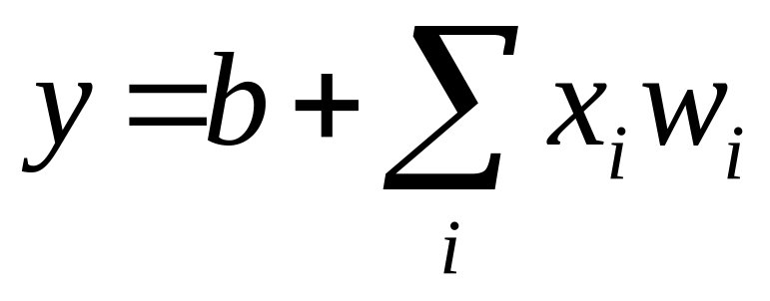
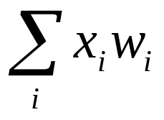
Linear neurons
Simple but limited
  If we can make them learn we may get insight into more complicated neurons
bias
i^{th} input
y
0
weight on
i^{th} input
(synaptic weight)
b
0
output
sum over inputs
Connectionist Computing COMP 30230
Notes:
draw it

Slide 24
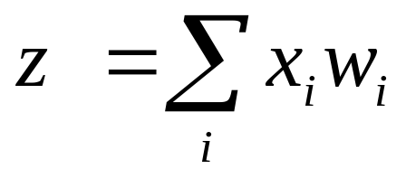
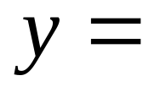
Binary threshold neurons
McCulloch-Pitts (1943):
  First compute a weighted sum of the inputs from other neurons
  Then send out a fixed size spike of activity if the weighted sum exceeds a threshold.
  Maybe each spike is like the truth value of a proposition and each neuron combines truth values to compute the truth value of another proposition.
1
1 if z>θ
y
0 otherwise
0
Connectionist Computing COMP 30230
z
threshold

Slide 25
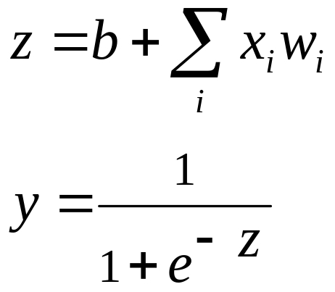


Sigmoid neurons
These give a real-valued output that is a smooth and bounded function of their total input.
  Typically they use the logistic function or tanh function
  They have nice derivatives which is why we like them.
If we treat y as a probability of producing a spike: stochastic binary neurons
Otherwise, simply a neuron that can be spiking a bit..
1
0.5
0
0
Connectionist Computing COMP 30230

Slide 26
Learning
We have a few simple models of neurons
Their behaviour depends on the value of their synaptic weights (free parameters).
How do we learn/adjust parameters?
Connectionist Computing COMP 30230

